Slide 1
Incentive funding: aB 617 Community air protection funds
Presented to The
AB 617 Community Steering Committee
for Calexico-Heber-El Centro Corridor
Imperial County Air Pollution Control District
December 17, 2018

Slide 2
Incentive Funding: AB 617 cap fUNDS
ICAPCD agreed to receive grant award of $500,000 through the Community Air Protection grant funds, authorized through Ab 134 for Fiscal Year 2017-2018.
Funds provided through Carl Moyer Memorial Air Quality Standards Attainment Program (Moyer) to reduce emissions in communities most heavily burdened by air pollution, in support of AB 617.
ICAPCD to prioritize zero emission vehicles or infrastructure, and consider zero-emission school buses and associated infrastructure with school districts.
Eligible School Bus Zero-Emission Replacement Projects have a State Funding Cap of $400,000, and cover up to 100% of the eligible cost of Project Infrastructure for “Public School Buses – Battery Charging and Alternative Fueling.”

Slide 3
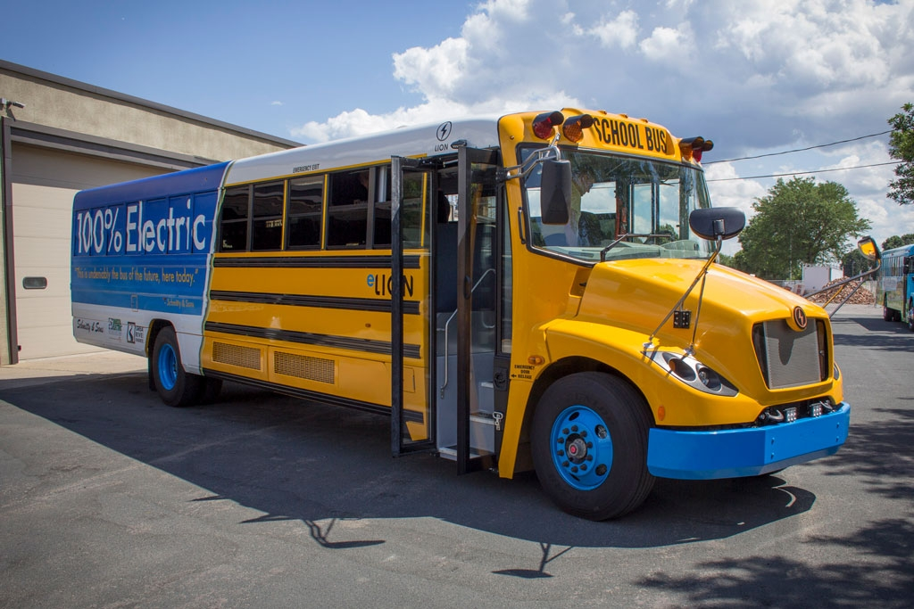
AB 617 CAP FUNDS
ICAPCD had an open Request for Proposal (RFP) for this grant opportunity, which ran from November 21, 2018 through December 6, 2018, for proposals that reduce mobile source emissions.
An application was submitted by Calexico Unified School District (CUSD) during the RFP period for a proposed School Bus Electrification Program.
Proposal consists of the replacement of One (1) 1996 diesel-fueled wheelchair school bus for CUSD with One (1) Blue Bird electric school bus, as well as the installation of the associated infrastructure (electrical bus charging pedestal stations) in shop area of CUSD Maintenance & Operations Department.
Proposal would satisfy the State Directive that funds prioritize emission reductions of vehicles which operate in identified AB 617 communities. In this case, the proposed project would occur in the AB 617 Community Corridor of Calexico-Heber-El Centro.

Slide 4
AB 617 CAP Funds – Resources
For more information, please go to ARB’s Webpage on CAP Incentives: https://www.arb.ca.gov/msprog/cap/capfunds.htm
ICAPCD Staff Contact: Thomas Brinkerhoff – (442) 265-1800; thomasbrinkerhoff@co.imperial.ca.us.

