Slide 1
Pesticide Use Enforcement
Rachel Garewal
Deputy Agricultural Commissioner

Slide 2
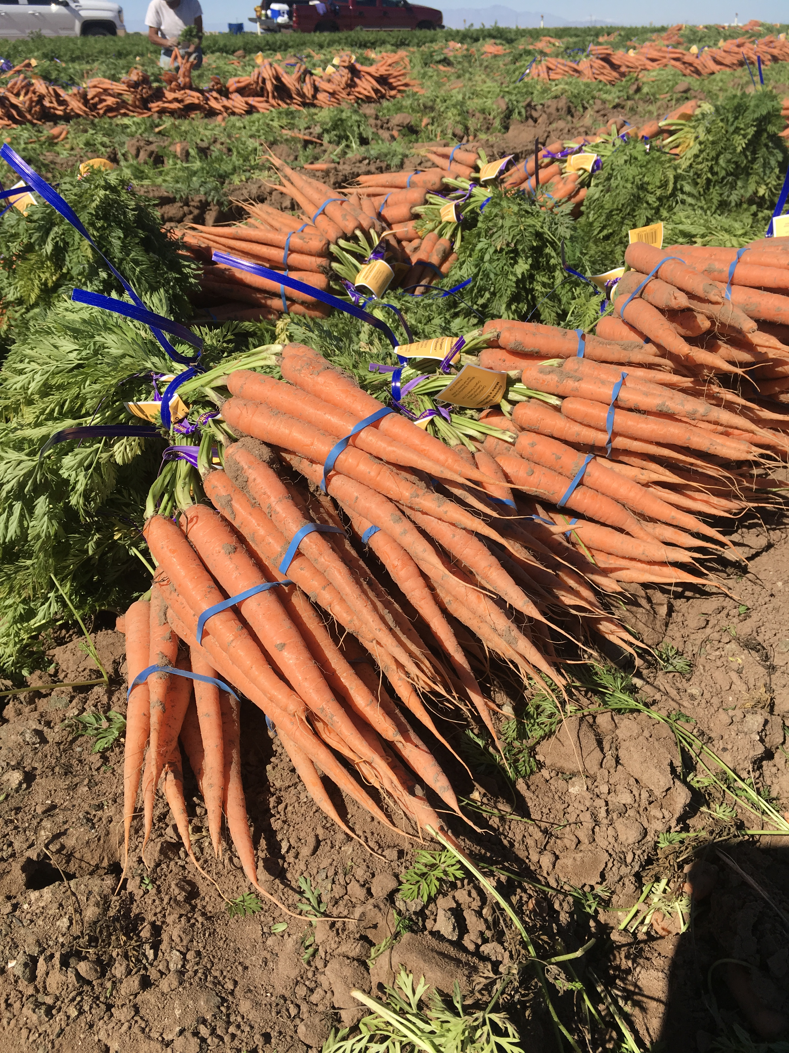
Mission & Purpose
“To promote and protect our agricultural industry by providing clear direction and appropriate regulatory oversight while protecting our citizens and the environment ...”
While pesticides are widely known to cause various types of harm, they are also an important tool in producing an agricultural commodity.
No local commercial farms are currently producing marketable products without pesticide use.
Even Organic fields are using pesticides.

Slide 3
Jurisdiction and Authority
Federal Insecticide, Fungicide, and Rodenticide Act establishes US EPA authority to regulate pesticides. US EPA maintains authority over pesticide labeling
State (DPR) Authority
Overall statewide enforcement – uniformity, training, coordination, etc.
Maintains authority to create regulation
County (CAC) Authority
Local program administration over pesticide use under DPR supervision and direction
Has authority to enforce existing regulations within Imperial County pertaining to pesticide use and levy civil penalties up to $5,000 per violation.

Slide 4
County PUE Programs
Permitting – Restricted Materials Permit, Operator ID Number
Registration & Private Applicator Certificate Issuance
pilots, businesses, advisors, farm labor contractors, structural, & beekeepers must register annually
Compliance Monitoring Inspections
Investigate Episodes / Complaints
Enforcement Response
Outreach

Slide 5
Restricted Materials Permitting
Restricted Materials – Pesticides deemed (legally) to have a higher potential to cause harm (human, environmental, crops)
CAC staff review permit application and sites of intended use and environmental impacts at each site. Then provide face to face explanation of county conditions and general pesticide use regulations at the time of permit signing.
Prior to application, operator must submit a Notice of Intent, which allows us an opportunity to visit the site and ensure that the surrounding environment has not changed or will not be substantially impacted.
2018: 35,248 total agricultural applications; of those 3,442 RMP:
methomyl – 1628
2,4-DB – 668
2,4-D – 516
chlorpyrifos – 452
diglycolamine salt (Clarity) – 178
1,3-D – 100
tributyl phosphorotrithioate (Folex) – 58
paraquat – 51
phorate – 37
carbaryl – 18

Slide 6
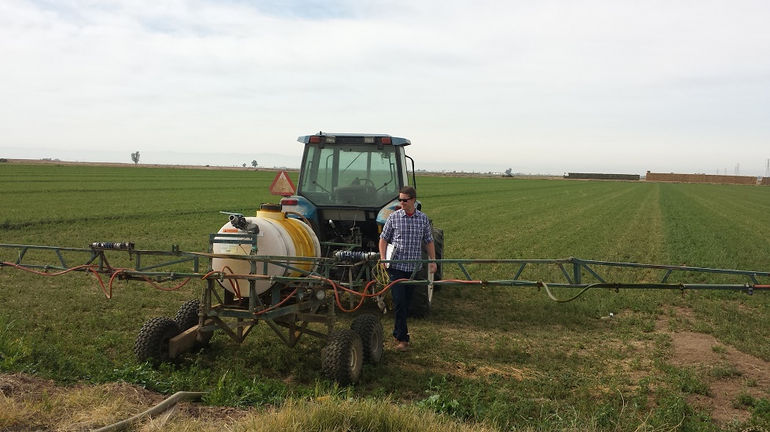
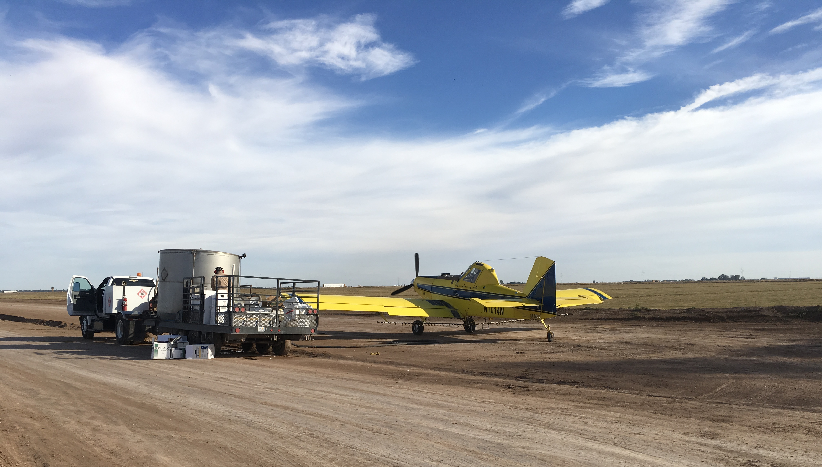
Application Inspections
Random surveillance for pesticide applications
Helps to ensure that applicators are following the rules and prevent harm to handlers, the public, etc.
2018: 290 application insp., 20 violations

Slide 7
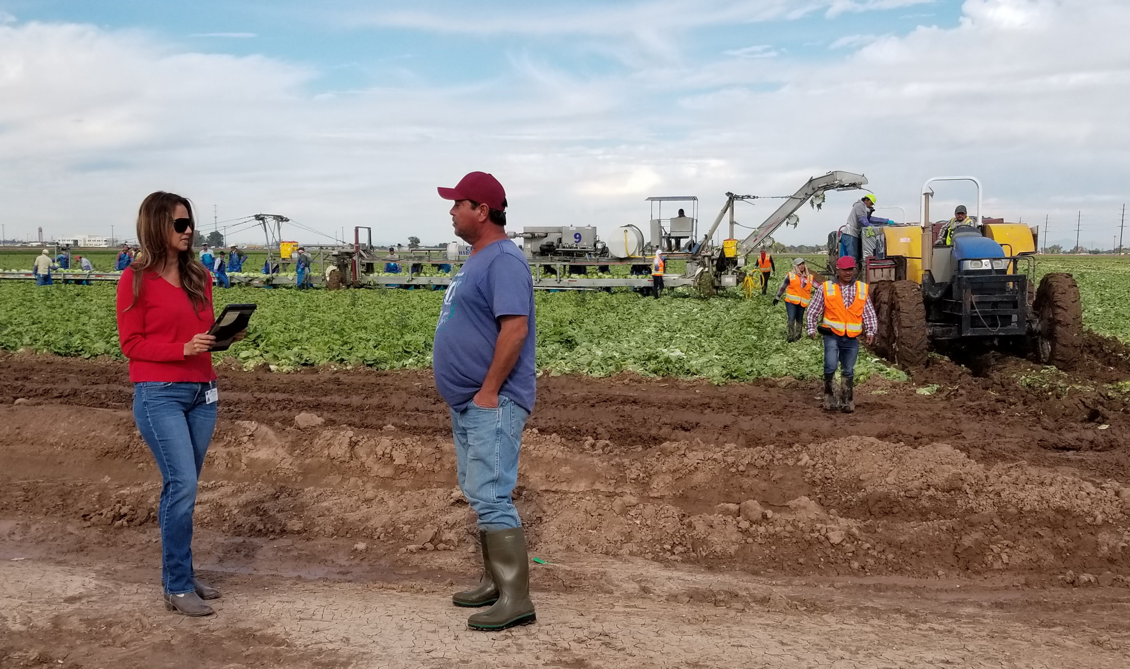
Field Worker Safety Insp.
Employers must provide pesticide safety training to field workers. Workers should understand their rights, & know how to determine if a field is safe to enter.
Inspectors interview crew, review records, and assess compliance.
2018: 136 field worker safety insp., 15 violations

Slide 8
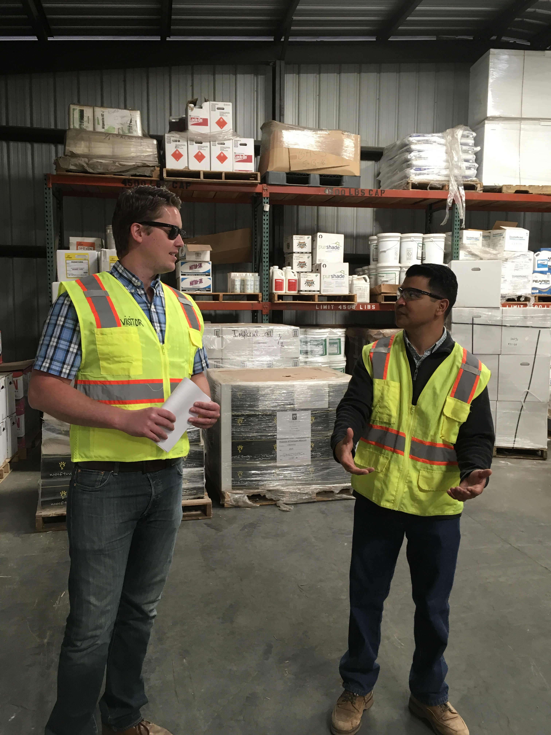
Headquarters Inspections
Scheduled visits – advisors, dealers, businesses, and growers
Inspecting for compliance with:
Record keeping
Employee training
Pesticide storage
If the operation uses certain pesticides they may also need:
Medical Supervision Program
Respiratory Protection Program
2018: 97 headquarters insp., 20 violations

Slide 9
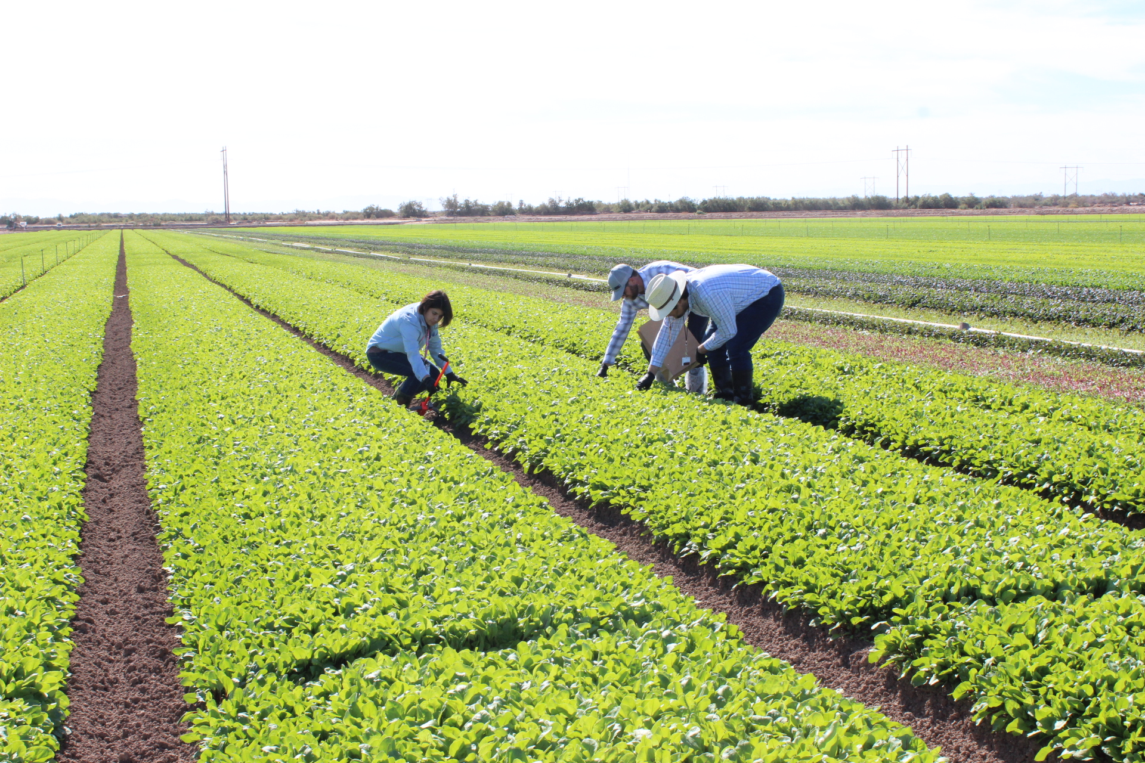
Investigation Objectives
Determine facts / collect evidence
Interview witnesses and people involved in incident
Obtain copies of pertinent documents
Samples for analytical testing
Take enforcement action when violations are found
2018: 55 investigations, 8 violations

Slide 10
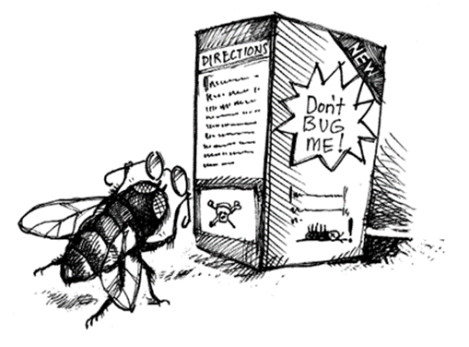
Human Effects
Pesticide Illness Reports referred by:
County Health Department
CA Poison Control
Doctor’s First Report
Vast majority of these cases involve sanitizers and/or incidents in the home
Lock up pesticide and chemical storage out of the reach of children
Never mix household cleansers
Follow label instructions
Never store chemicals in food/water containers
2018: 22 human exposure investigations. 55% were these types of cases, mostly sanitizers.

Slide 11
Enforcement Response
CAC is required to “dispose” of each violation found following state guidelines. Our disposition is monitored by DPR to ensure compliance.
Generally, entities receive a warning on their first offense. If the violation is severe, we will issue a citation on the first offense.
After an entity has had a warning on a moderate violation, CAC is required to issues citations for subsequent violations (excluding minor violations).
2018: 30 citations issued (1 in progress), totaling $34,050

Slide 12
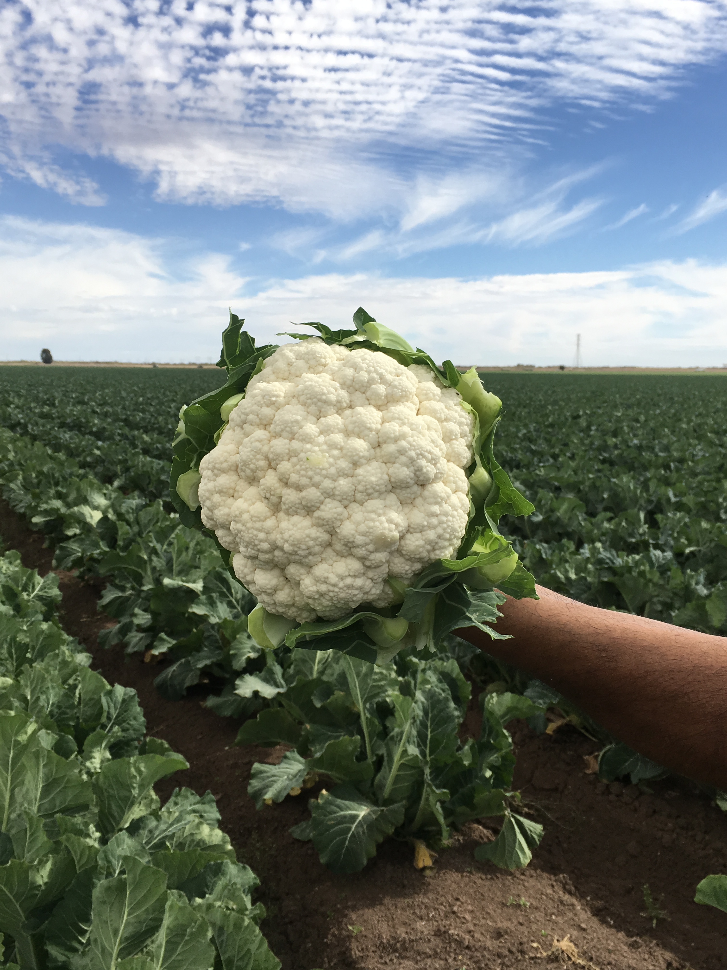
Questions
Rachel Garewal
(442) 265-1500
agcom@co.imperial.ca.us
https://www.co.imperial.ca.us/ag/

