Slide 1
Clean Air for Schools Program

Slide 2
The IQAir Foundation works to bring clean air to
more than 1 million children.
IQAir Foundation Mission Statement
The IQAir Foundation seeks to promote environmental justice by helping to improve environmental health conditions in neighborhoods unfairly affected by pollution as a result of economic, ethnic or racial factors.
Through Clean Air for Kids, IQAir Foundation has a goal to bring air filtration to at least 120,000 additional school children every year, which supports the IQAir Foundation’s overarching goal of providing clean air to more than 1 million children.
1 Million Children

Slide 3
The Problem
Pollution
Children in Imperial County are exposed to pollutants every day:
Schools located near freeways
Homes located near freeways
Indoor Air Quality pollutants
Climate change
Sources of pollutants and emissions:
CO₂ released from diesel trucks and some older cars
Refineries and factories
Other pollutants

Slide 4
Mitigation
The Solution
Clean Air for Schools
We don’t need to wait 20 years for the air to be cleaner in order to mitigate air pollution. Children in impacted communities can
breathe up to 90% cleaner air today through the Clean Air for School Program has funding available for impacted areas.
Breathe Clean Air Today
Children can breathe clean air in schools today!

Slide 5
Clean Air for Schools
The Solution: Clean Air for Schools

Slide 6
Key benefits of the Clean Air School Program
The Solution: Clean Air for Schools
Clean Air: The program provides up to a 90% reduction of harmful pollutant particles inclassrooms.
Quieter Classrooms: The program quiets c las srooms suffering from noisy HVAC systems and brings them in line with recommended sound leve ls of 45 decibels or less.
Key Benefits
Recommended Ventilation Rates: Classrooms without automatic HVAC operation will be brought into compliance with classroom ventilation requirements and best practices.
Green: The Clean Air School Program monitors HVAC filter life with differential pressure drop, as recommended by the EPA and Collaborative for High Performance Schools.
Energy Efficient: Program schools save energy while
promoting a healthful learning environment through the use of smart occupancy-based HVAC energy monitors.

Slide 7
The Solution: Clean Air for Schools
The road to becoming a Clean Air School includes these steps:
Assessment and Creation of a Solutions Report: Clean air specialists assess your school buildings and mechanical systems. They generate a comprehensive Solutions Report including recommended technology installations and other actions to improve air quality and optimize heating, ventilation and air conditioning systems performance.
Funding Opportunities :
SEP
Installation of one or a combination of recommended technologies : Air cleaning and HVAC specialists install upgraded HVAC filters , stand alone air filtration systems, occupancy-based HVAC energy management systems, HVAC silencers and other recommended technologies.
Verification: Air cleaning and HVAC specialists verify that your school meets the Clean Air School Requirements.
Continuous monitoring and maintenance: Your school’s facilities and maintenance staff is trained on the newly installed technologies, filter replacement and other maintenance requirements. The installation team continues to check in and monitor system performance throughout the designated contract period.

Slide 8
Administrators at the district and school levels play a key role
The Solution: Clean Air for Schools
As school administrators, including principals, your leadership and support for the Clean Air Program is vital. Success requires collaboration
between you, teachers, staff, facilities and maintenance personnel and, of course, students and parents. Your role in supporting the Clean Air Schools Program at your school or in your district might include:
Engage As Lead ers
Engaging teachers and staff in a dialogue of support to meet the requirements of the program.
Sending a pamphlet to parents of students regarding the Clean Air School Program. IQAir Foundation can supply you with suitable
templates.
Hosting an introductory on-site meeting for the Clean Air School Program with teachers, facilities and maintenance personnel and other key s taff.
Engaging in community/ media-relations events , this is an optional event where a certification plaque is awarded to the school.

Slide 9
The Solution: Clean Air for Schools
Nearly 100,000 school children in over 150 schools in California have been upgraded with clean air technologies.
The program’s comprehensive approach removes up to 90% of outdoor ultra-fine particles, such as diesel soot.
The Process
More than 100 air filtration manufacturers were contacted and submitted their technologies for testing.
Submissions included HVAC-mounted filtration systems and standalone systems.
Testing was conducted in a portable classroom at Sunnyslope Elementary School in Riverside, Calif. The classroom is typical of those in public school districts throughout the U.S.
3,000 Classrooms
Results
The final report, “Performance Evaluation of Air Filtration Devices,” was prepared for the South Coast Air Quality Management District (SCAQMD) in late 2010. Research was conducted by Dr. Robert L. Russell, William A. Welch and James Gutierrez.

Slide 10
Pilot study: high-performance air filtration for classrooms
The Solution: Environmental Justice and Air Filtration
Conducted in 2008 with South Coast Air Quality Management District (SCAQMD)
9 classrooms at 3 elementary schools in 2 districts
Los Angeles Unified School District: Del Amo Elementary & Dominguez Elementary
Long Beach Unified School District: Hudson Elementary
90% Effective
Investigated effectiveness of three air purification systems in reducing and removing contaminants
HVAC-based high-performance panel filter
Register-based air purifier
Stand alone system
Findings : IQAir technology removed up to 90% of diesel soot, particulate matter and other pollutants in classrooms.

Slide 11
The Solution: Clean Air for Schools
Customized solutions for individual schools include the following technologies:
Air quality monitors
Upgraded HVAC panel filters
Standalone air filtration systems
Diffuser and other HVAC upgrades
HVAC silencers and other noise abatements
Filter life sensors
Customized Solutions

Slide 12
World’s Smartest Air Quality Monitor
IQAir Solutions for Air Quality Issues
Air Quality Monitoring: IQAir AirVisual Pro
The world’s smartest air quality monitor
Monitor outdoor and Indoor Air Quality
In real time including CO₂ and particulate matter from streets and highways.
View data from an international network of air quality monitors.
Use the free AirVisual App to access the world’s largest air quality database of over 10,000 cities.

Slide 13
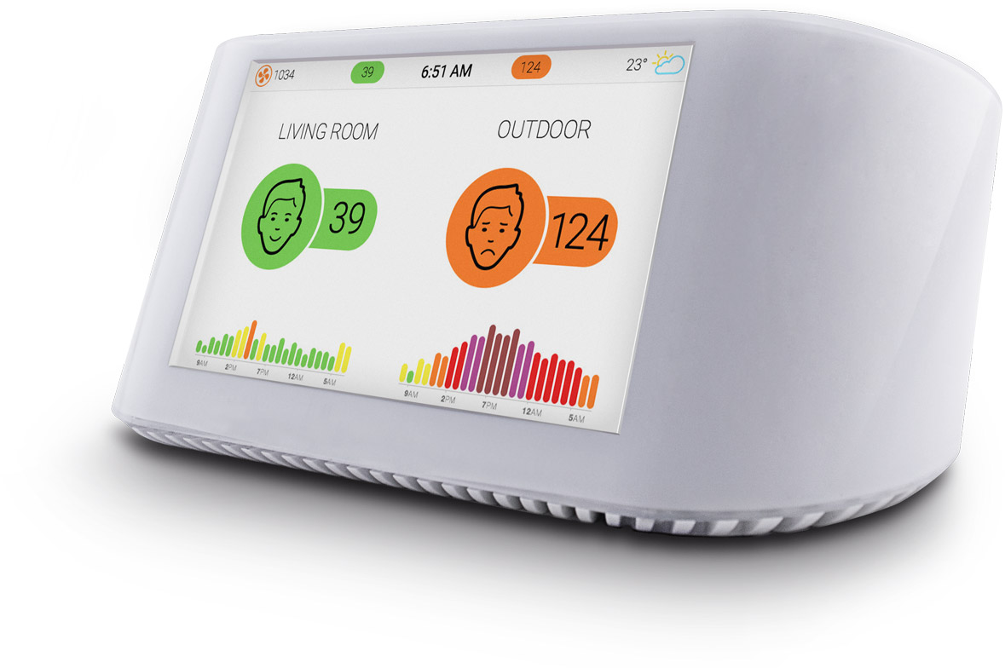
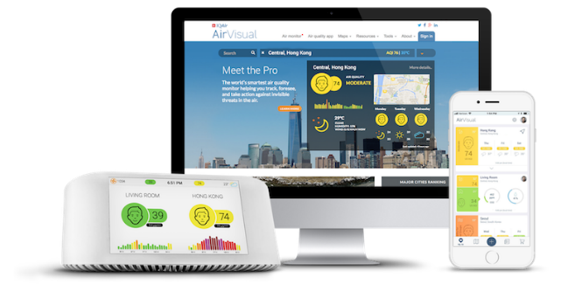
AirVisual Pro
The World’s Smartest Air Quality Monitor
Real-time PM2.5, CO₂, temperature and humidity
72-hour historical and forecast air quality data from over 10,000 cities worldwide
Works with IFTTT
5-inch LED screen
Rechargeable Li-ion battery
802.11 b/g/n 2.4 GHz
Mobile app and website*
AirVisual Pro
MAP: $269
* #1 Air Quality App in the US and World Wide

Slide 14
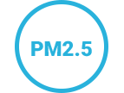
AirVisual Pro
PM2.5 are tiny particles that damage your throat and lungs. This pollutant is particularly dangerous as its small size allows particles to directly enter your bloodstream from your lungs.
High CO2 levels mean you need fresh air. Stagnant air has less oxygen, and more bacteria, mold, and other harmful fumes.
See your indoor air quality next to outdoor readings from the nearest official monitoring station.
Make sure your environment is comfortable, as well as healthy.
Dry air contributes to irritated sinuses, sore throat, itchy eyes and skin aging. Meanwhile, overly humid environments can bring about biological air pollutants such as dust mites and mold.
Plan ahead to minimize pollution exposure and discomfort outdoors. We’ll keep you informed with air quality and weather data up to 3 days in advance.
We take all of your air quality data into account so you don’t have to. The AirVisual Pro learns from your indoor and outdoor environments to provide you the most productive and cost effective recommendations.
Receive notifications when air quality fails to meet standards. Smart integration allows you to control smart home devices with action-based rules.

Slide 15
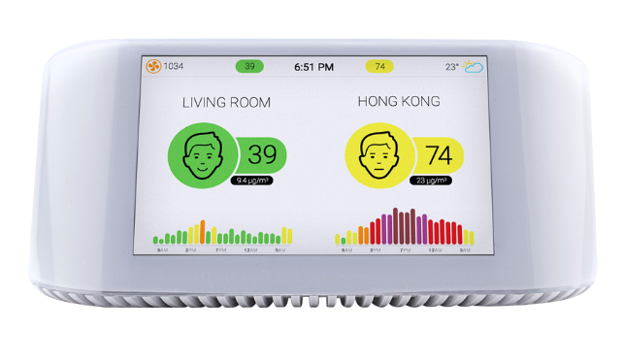
AirVisual Pro
Advanced Features
Hardware
Cutting–edge laser technology counts microscopic PM2.5 particles in the air. Airflow control fans provide stable, reliable readings and improved durability.
Accuracy
The AirVisual Pro is the most accurate low-cost consumer device. Auto-calibration components instantly consider factors like temperature, humidity and outlying data points.
Network + Analytics
Cloud computing, big data and artificial intelligence provide the best predictive analytics in a compact, portable device.
Works with IFTTT
Control other smart devices with the five triggers; temperature, Humidity, CO2, AQI, and PM 2.5.

Slide 16
AirVisual Pro
High CO2 levels mean you need fresh air. Stagnant air has less oxygen, and more bacteria, mold, and other harmful fumes.
See your indoor air quality next to outdoor readings from the nearest official monitoring station.
PM2.5 are tiny particles that damage your throat and lungs. This pollutant is particularly dangerous as its small size allows particles to directly enter your bloodstream from your lungs.
Make sure your environment is comfortable, as well as healthy.
Plan ahead to minimize pollution exposure and discomfort outdoors. We’ll keep you informed with air quality and weather data up to 3 days in advance.
Dry air contributes to irritated sinuses, sore throat, itchy eyes and skin aging. Meanwhile, overly humid environments can bring about biological air pollutants such as dust mites and mold.
We take all of your air quality data into account so you don’t have to. The AirVisual Pro learns from your indoor and outdoor environments to provide you the most productive and cost effective recommendations.
Receive notifications when air quality fails to meet standards. Smart integration allows you to control smart home devices with action-based rules.

Slide 17
IQAir Solutions for Air Quality Issues
Clean Air Technology..Its Time to Make a Difference in
classrooms and the communities.
Get Involved
Thank you.

