Slide 1

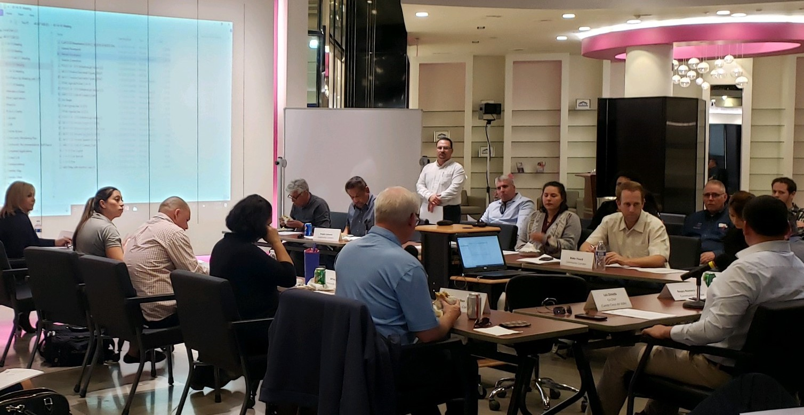
Community Air Monitoring Plan Refresher
Imperial County AB 617 Community Steering Committee Meeting
February 12, 2020

Slide 2
Community Air Monitoring Plan
Primary air Quality Objectives
The CAMP establishes three main air monitoring objectives:
Utilize the data collected by regulatory monitors to track the progress of the Community Emissions Reduction Program (CERP).
Deploy and operate sufficient monitoring to provide real-time air quality data to the Community that is easy to understand and covers a greater area with increased resolution compared to the current monitoring networks.
Leverage additional complementary monitoring to evaluate source impacts and identify and characterize hotspots.

Slide 3
Community Air Monitoring Plan
3-Level monitoring approach
To achieve the goals of the CAMP, the following 3-Level approach is being implemented:
REGULATORY MONITORING:
To utilize the data from the 2 existing regulatory monitoring stations within the Community - the El Centro monitoring station & the Calexico-Ethel monitoring station.
The rich data history and reliability of these monitors is useful to track trends of monitored pollutants in the Community.
Under the CAMP, annual average and 24-hour concentrations of PM_{2.5} and PM₁₀ will be analyzed to measure the progress of the Community’s CERP.
Data from these 2 monitors will be made public via CARB’s AQ View platform, and pollutant trends will be published in an annual progress report posted on the ICAPCD’s AB 617 website.

Slide 4
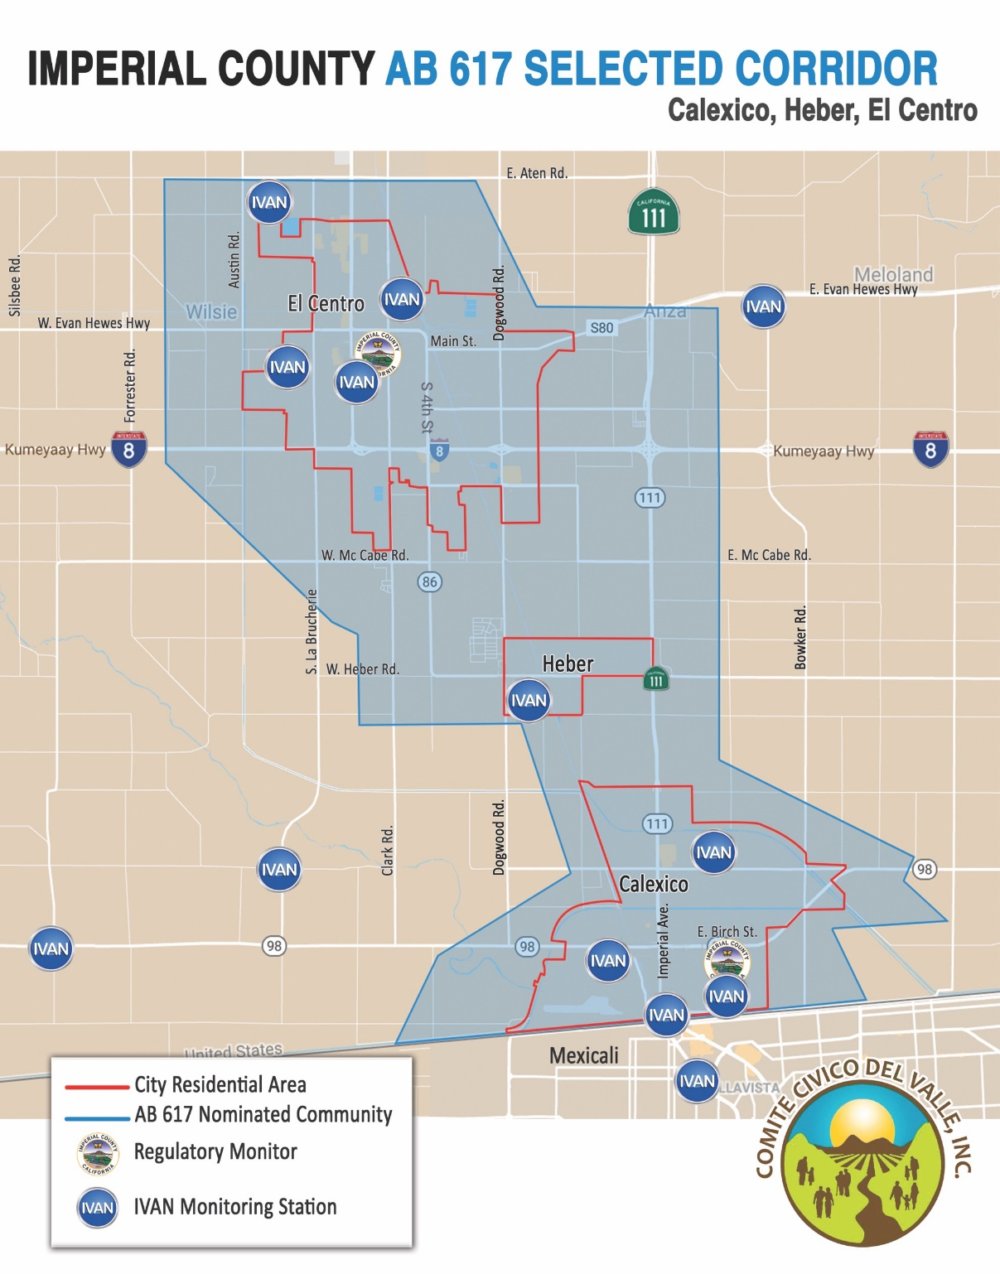
Community Air Monitoring Plan
3-Level monitoring approach
ADDING TO EXISTING COMMUNITY AIR MONITORING NETWORK:
9 community air monitors in the Corridor as part of IVAN Imperial that collect and report real-time particulate matter.
CAMP outlines that 15 new community monitors to be added to the corridor, coming from 15 primary locations selected by CSC (and 10 alternate locations when required)
Just as the data from the 2 regulatory monitors, data from the new community air monitors will be made public via CARB’s AQ View platform and through an annual progress report posted on the ICAPCD’s AB 617 website.

Slide 5
Community Air Monitoring Plan
3-Level monitoring approach
3. COMPLEMENTARY MONITORING - MOBILE MONITOR UNIT(S):
To complement the existing 2 regulatory monitors and 15 additional community air monitors community air monitors, the CAMP calls for the deployment of 1-2 mobile monitoring platforms.
The mobile monitoring platforms will consist of high-grade, regulatory quality monitoring equipment, which can be deployed at different locations throughout the Community.
The platforms could be designed to monitor a wide range of pollutants, such as NOx, VOCs, Black Carbon, and various toxics, allowing the CSC to address a broader range of air quality concerns.
The design and types of monitoring instruments for the platforms is currently in development with the CSC.

