Slide 1
Overview of Pesticide Regulation and Pesticide Air Monitoring in Imperial County
Edgar Vidrio
Air Program | California Department of Pesticide Regulation
May 2019

Slide 2
California Toxic Air Contaminant Act
Created a statutory framework for the evaluation and control of chemicals (including pesticides) as toxic air contaminants (TACs)
Specifically, California Food and Agricultural Code sections 14021-14027 requires:
The California Air Resources Board (CARB) to monitor for potential pesticide TACs at request of the California Department of Pesticide Regulation (DPR)
DPR to assess risks from air exposures of potential pesticide TACs
DPR to mitigate risks from pesticide listed as TACs
Currently, there are a total of 48 pesticide TACs, of which 9 have active registrations and use in California

Slide 3
Health Risk Assessments for Potential Toxic Air Contaminants
DPR risk assessments include
Potential health effects
Levels that have little or no risk – reference concentrations
Exposure levels
Office of Environmental Health Hazard Assessment (OEHHA) and scientific review panel (SRP) review
If criteria met, DPR must follow formal rulemaking process to list pesticide as a toxic air contaminant
Notes:
Air monitoring used to
- Assess exposures and health risk
- Develop mitigation measures
- Evaluate effectiveness of mitigation measures

Slide 4
Risk Reduction for Toxic Air Contaminants
DPR must determine the need to reduce risk – regulatory target concentration
If needed, DPR must implement measures to reduce exposures within 2 years, such as
Application method restrictions
Buffer zones (distance to a target concentration)
Limits on amount applied
DPR must develop exposure reduction measures in consultation with certain agencies, including ARB and air pollution control districts

Slide 5
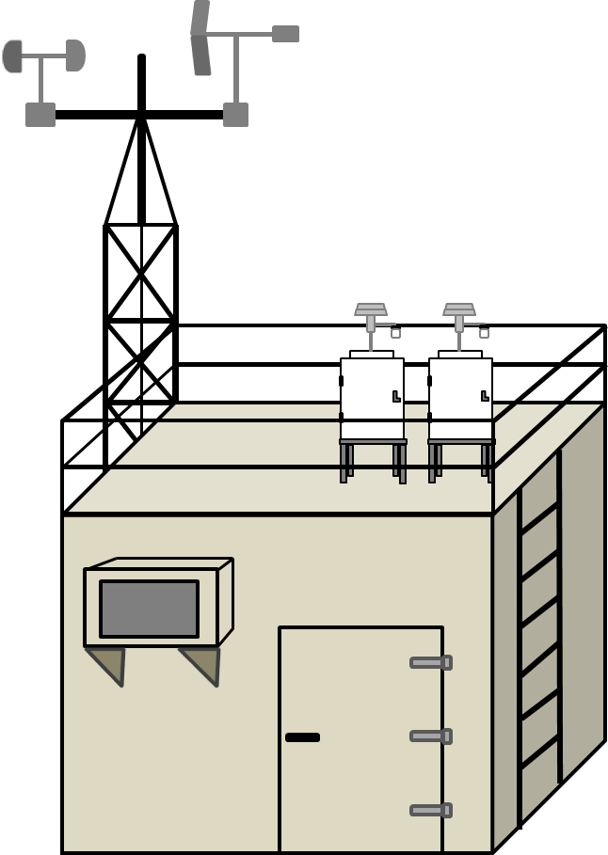
Monitoring for Toxic Air Contaminants
DPR performs air monitoring to:
Identify pesticides in air
Determine acute, seasonal, or annual concentrations and exposures
Track trends in air concentrations over time
Determine if mitigation measures are working

Slide 6
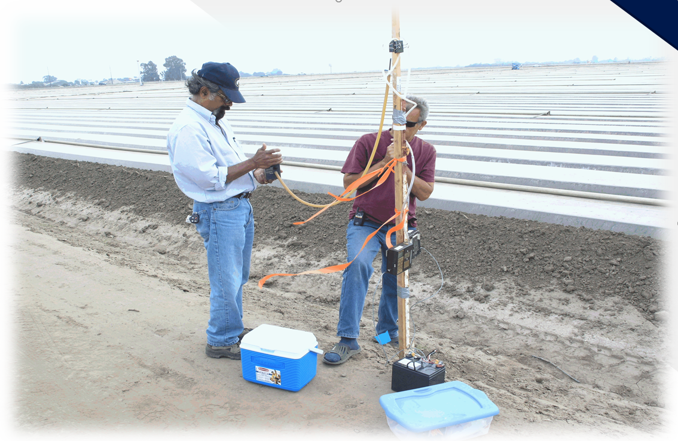
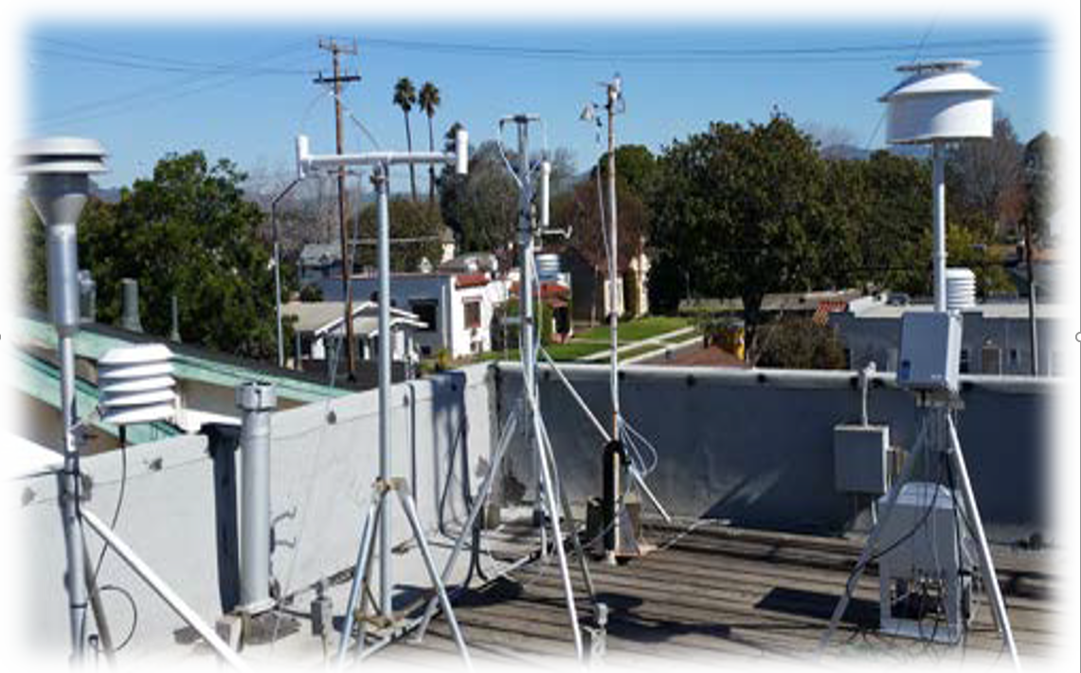
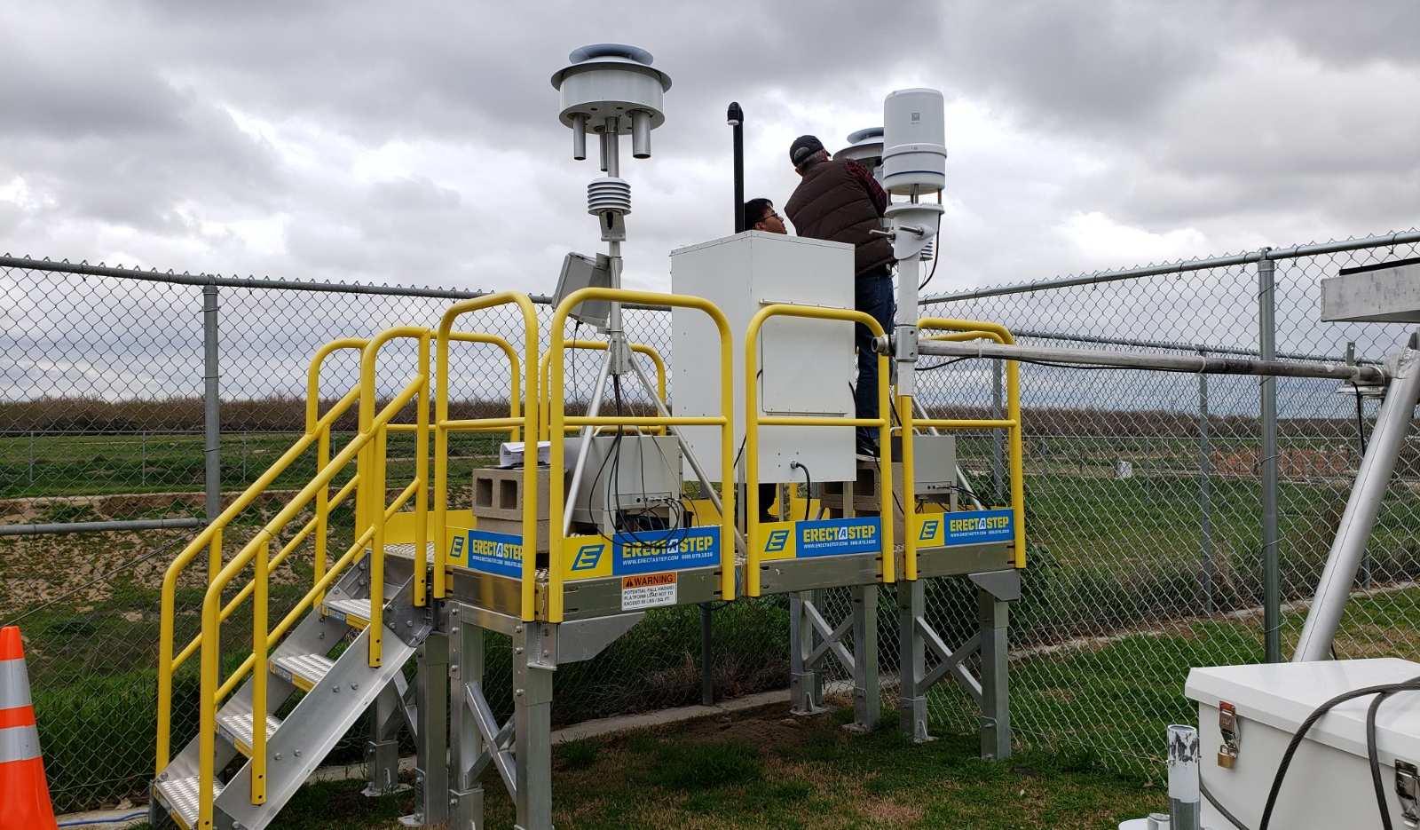
Types of Pesticide Air Monitoring
Application-site monitoring occurs near specific applications for several days.
Data best used to estimate maximum exposures over hours or days
Seasonal monitoring is conducted in communities of higher pesticide use relative to other communities. Monitoring for 8-12 week period that coordinates with the historical use season for the selected pesticides.
Data best used to estimate maximum exposures over weeks or months
Long-term monitoring: Continuous weekly sampling in communities with higher use of multiple pesticides relative to other communities.
Data best used to estimate maximum exposures over years

Slide 7
Air Monitoring Considerations
Monitoring for ambient airborne pesticides using “real-time” approaches is not currently possible for most pesticides; therefore, air samples are collected using pumps and trapped in canisters or sorption tubes.
Upon collection, pesticide air samples need to be immediately placed under low temperatures (-109.3 °F) to prevent sample loss due to volatilization/degradation.
Collected air samples need to be transported to an analytical laboratory for analysis.
Process is labor intensive and can take anywhere from 2-4 months to obtain results.

Slide 8
Evaluation of Air Monitoring Data
DPR health screening levels – A concentration that is above the screening level indicates the need for a further and more refined evaluation.
DPR regulatory target concentrations – concentrations designed to protect against adverse health effects. Exceeding a regulatory target concentration does not necessarily mean an adverse health effect occurs, but it indicates restrictions on the pesticide use may need to be modified.
Evaluation of monitoring data and computer modeling may lead DPR to develop additional measures to reduce exposures
Notes:
Screening levels are based on a preliminary scientific evaluation of potential toxic effects.
Regulatory targets are developed after a comprehensive evaluation of potential toxic effects and current exposure levels. DPR management has determined that current exposure levels need to reduced down to the target concentration. The regulatory target is based on the scientific evaluation, but also takes into account the uncertainties in the evaluation, severity of potential toxic effects, potential changes in use of other pesticides, and other factors.

Slide 9
2018 Seasonal Monitoring for Organophosphate Pesticides In Imperial County
At DPR’s request, in 2018 the CARB conducted a seasonal air monitoring study for 11 organophosphate pesticide active ingredients in Imperial County.
The monitoring was conducted in the communities of Brawley (2 sites), Heber, Imperial, Seeley, and Westmorland from January 16, 2018 through March 20, 2018.
Four consecutive 24-hr air samples were collected each week at each sampling location.
One site (Brawley SDSU) was operated by Comite Civico Del Valle (CCV) staff.

Slide 10
Summary of 2018 Seasonal Organophosphate Monitoring in Imperial County
Site Name | Total Air Samples Collected | Number of Analyses | Number of Quantifiable Detections | Number of Trace Detections | Percentage of Quantifiable Detections | Percentage of Trace Detections
Brawley | 43 | 471 | 0 | 3 | NA | 0.6%
Brawley SDSU | 11 | 121 | 0 | 3 | NA | 2.5%
Heber | 40 | 438 | 1 | 5 | 0.2% | 1.1%
Imperial | 38 | 416 | 2 | 9 | 0.5% | 2.2%
Seeley | 40 | 438 | 1 | 6 | 0.2% | 1.4%
Westmorland | 41 | 449 | 22 | 12 | 4.9% | 2.7%
Totals | 213 | 2,333 | 26 | 38 | 1.1% | 1.6%

Slide 11
Summary of 2018 Seasonal Organophosphate Monitoring in Imperial County
Pesticide | Maximum 24-hr air concentrations per sampling location |  |  |  |  |  | 24-Hr Acute Screening Level
 | Brawley | Brawley SDSU | Heber | Imperial | Seeley | Westmorland
Chlorpyrifos | nd | nd | nd | nd | nd | 38.8 | 1,200
Chlorpyrifos OA | nd | nd | nd | nd | nd | 33.9 | 1,200
Dichlorvos (DDVP) | nd | nd | nd | nd | nd | nd | 11,000
DEF | nd | nd | nd | nd | nd | 38.1 | 8,800
Diazinon | nd | nd | nd | 17.4 | nd | 32.5 | 130
Diazinon OA | nd | nd | nd | nd | nd | 33.9 | 130
Dimethoate | nd | nd | nd | nd | nd | 45.9 | 4,300
Dimethoate OA | nd | nd | 20.0 | 18.8 | 109.3 | 30.3 | 4,300
Malathion | nd | nd | nd | nd | nd | 212.1 | 112,500
Malathion OA | nd | nd | nd | nd | nd | 62.3 | 112,500
Phosmet | nd | nd | nd | nd | nd | 50.8 | 77,000
nd = not detected

Slide 12
Summary of 2018 Seasonal Organophosphate Monitoring in Imperial County
Pesticide | Maximum 24-hr air concentrations as a percentage of screening level |  |  |  |  |  | 24-Hr Acute Screening Level
 | Brawley | Brawley SDSU | Heber | Imperial | Seeley | Westmorland
Chlorpyrifos | -- | -- | -- | -- | -- | 3.2% | 1,200
Chlorpyrifos OA | -- | -- | -- | -- | -- | 2.8% | 1,200
Dichlorvos (DDVP) | -- | -- | -- | -- | -- | -- | 11,000
DEF | -- | -- | -- | -- | -- | 0.4% | 8,800
Diazinon | -- | -- | -- | 13.4% | -- | 25.0% | 130
Diazinon OA | -- | -- | -- | -- | -- | 26.1% | 130
Dimethoate | -- | -- | -- | -- | -- | 1.1% | 4,300
Dimethoate OA | -- | -- | 0.5% | 0.4% | 2.5% | 0.7% | 4,300
Malathion | -- | -- | -- | -- | -- | 0.2% | 112,500
Malathion OA | -- | -- | -- | -- | -- | 0.1% | 112,500
Phosmet | -- | -- | -- | -- | -- | 0.1% | 77,000

Slide 13
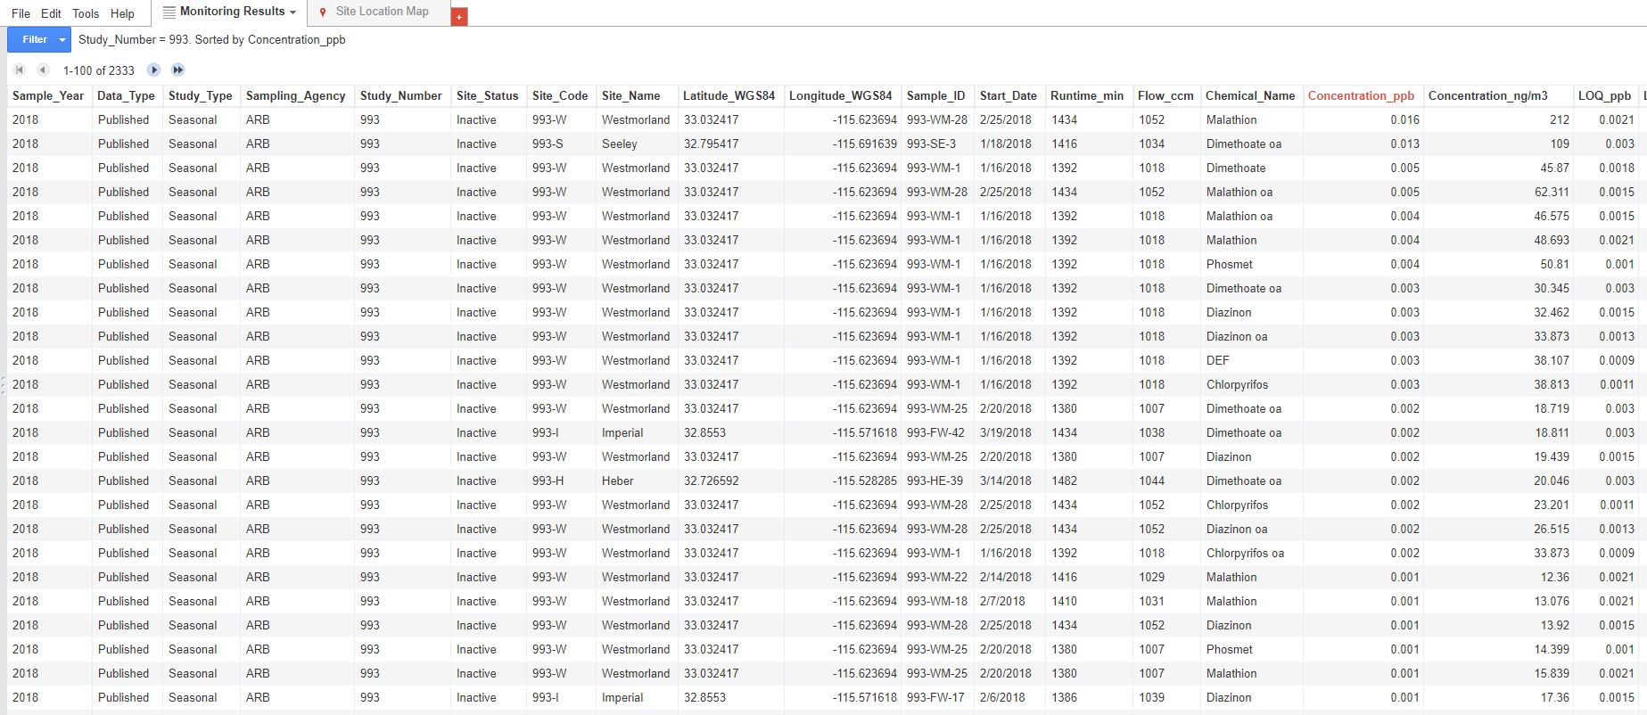
DPR’s pesticide air monitoring results database
https://www.cdpr.ca.gov/docs/emon/airinit/pesticide_air_monitoring_database.htm

