Slide 1
AQview Community Air Quality Viewer
June 19, 2019
Emily Gorrie + Taylor Helgestad

Slide 2
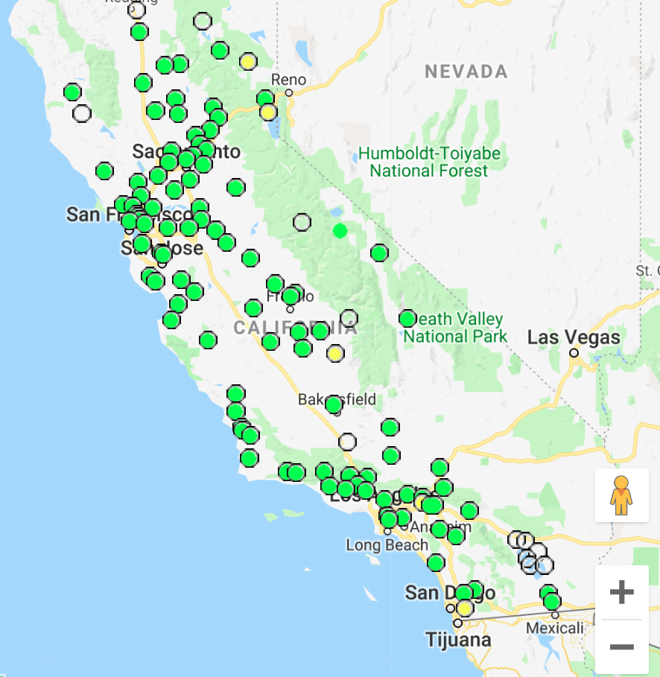
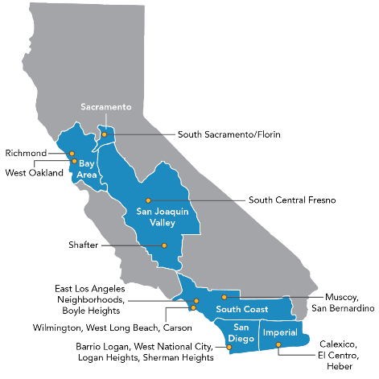
Assembly Bill 617 (AB 617)
Existing Regulatory Network
Assessing Clean Air Act attainment
Regionally focused
State and District run sites
AB 617
Air pollution reduction in specific communities
Locally focused
Many monitoring data sources
Regulatory Network
AB 617 Communities

Slide 3
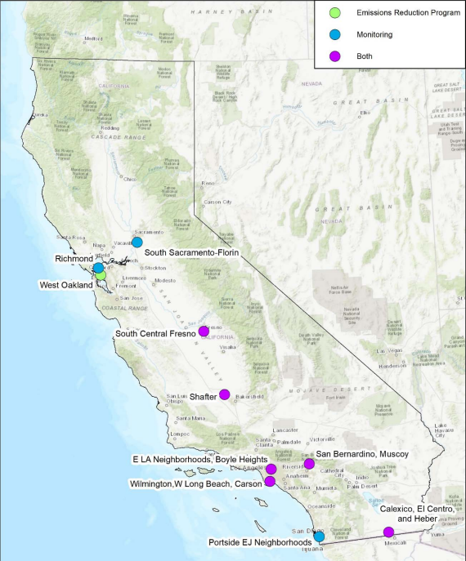
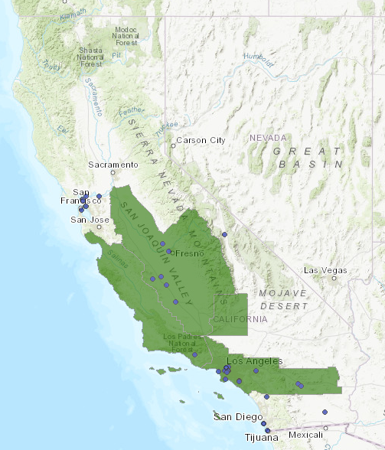
Community Air Monitoring
AB 617 - Year One
9 communities selected for monitoring programs
Monitoring efforts led by Air Districts
23 projects with monitoring selected for Community Air Grants
Monitoring efforts led by Community Based Organizations
Challenges
Various monitoring objectives
Combination of regulatory-grade equipment and low-cost sensors
Selected Communities (2018)
Air Grant Awardees (2018-2019)

Slide 4
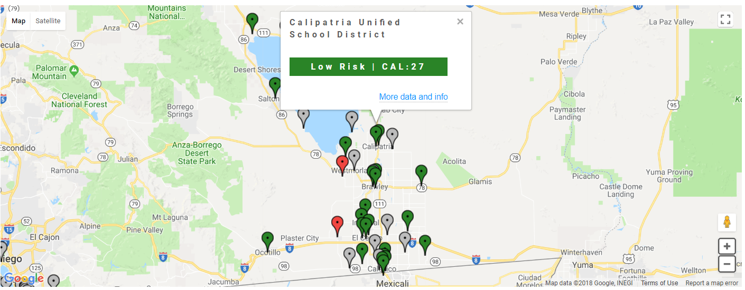
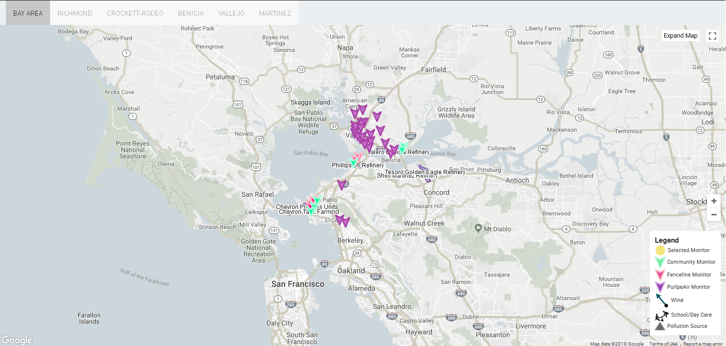
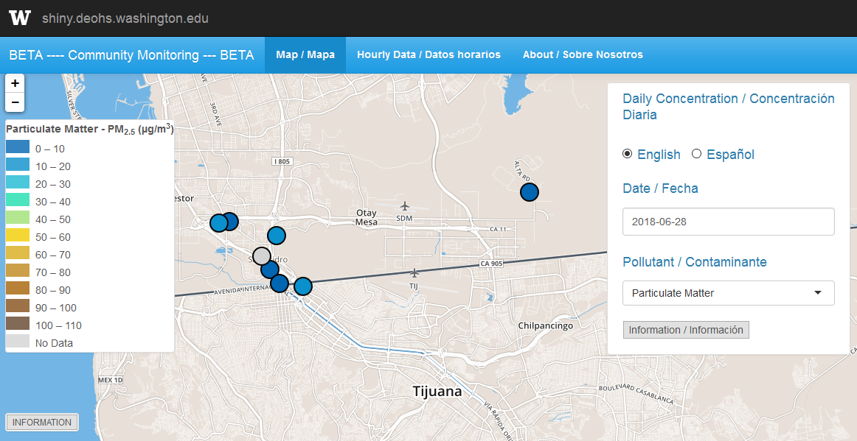
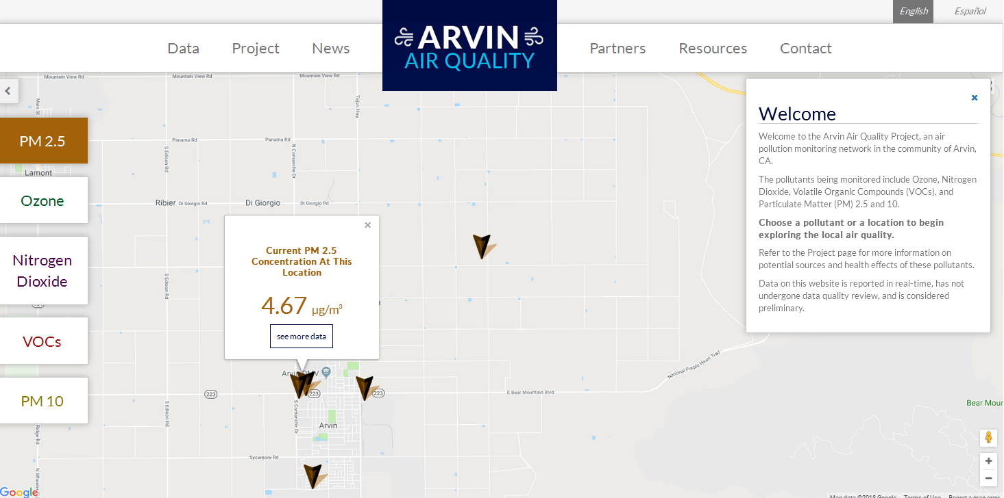
Existing Data Portals
Examples
IVAN
Air Watch Bay Area
San Ysidro Air Study
Arvin Air Quality

Slide 5
AQview Goals
Data Quality
Interpretation
Data Accessibility
Track emission reduction progress
Increase awareness of exposure and potential health effects from exposure
Improve access to air quality data
Improve overall transparency

Slide 6
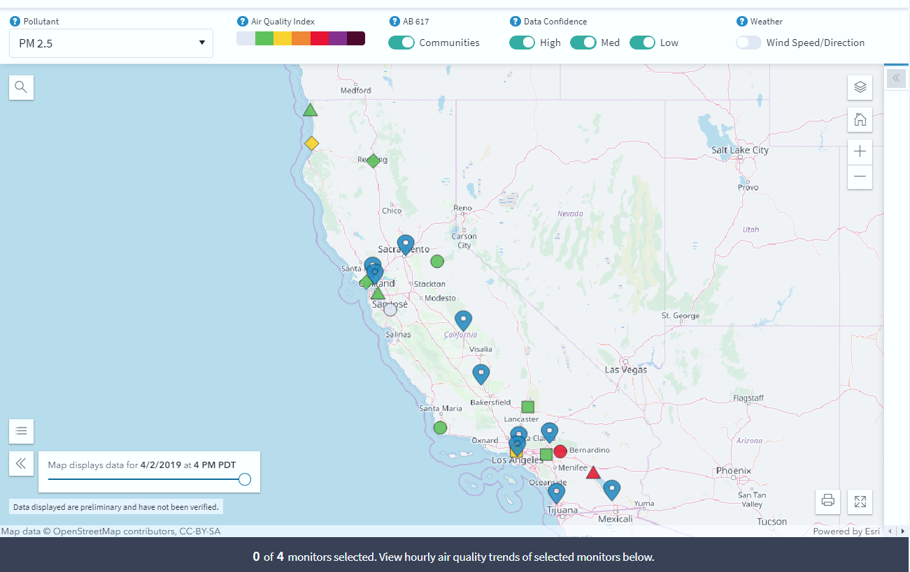
State View (Draft)

Slide 7
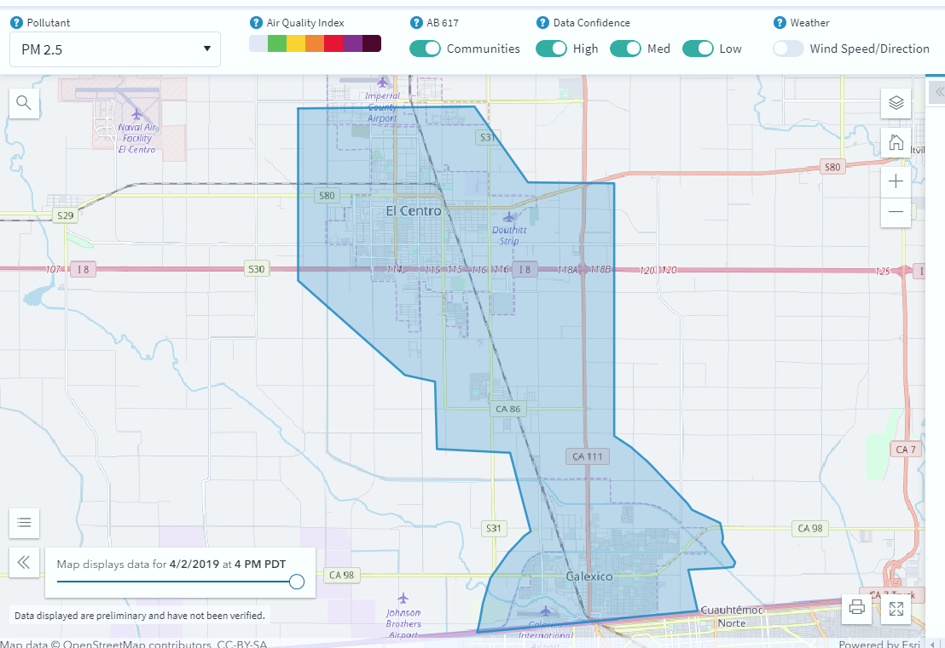
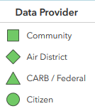
Community View (Draft)

Slide 8
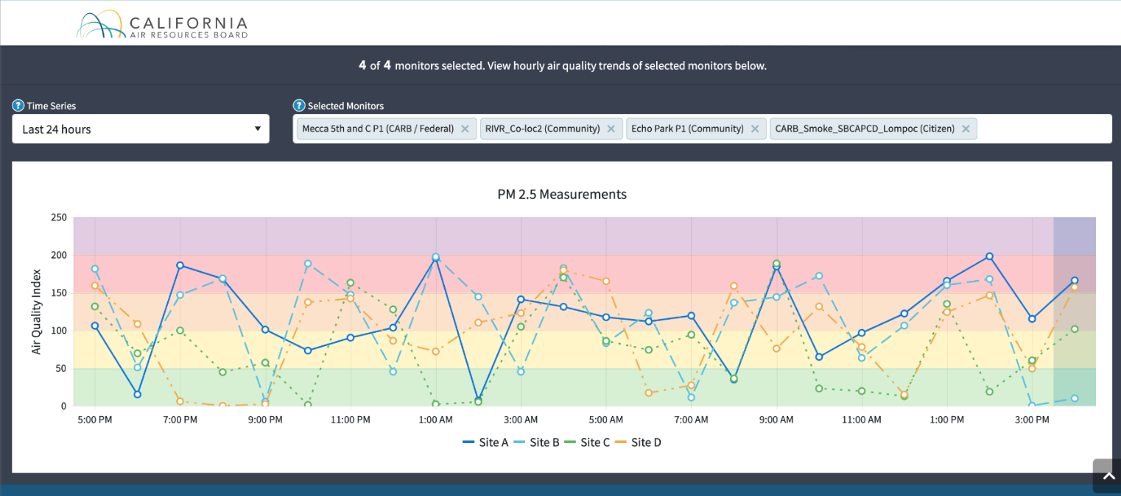
Time Series (Draft)

Slide 9
Contact the Team
AQview Team
aqview@arb.ca.gov
Mena Shah (Supervisor)
Taylor Helgestad
Emily Gorrie
Annie Flores
Rai Hann

