Slide 1
Source Attribution
AB 617 Community Air Protection Program
December 17, 2018

Slide 2
AB 617 Process and Source Attribution
Engagement
Analysis
Action
Meet with community
Identify topics/sources of concern
Analyze existing data in context of community concerns
Identify data gaps and source attribution needs
Develop strategies for monitoring and emissions reductions using best available data
Implementation Community Emissions Reduction Program
Deploy Community Air Monitoring Plan
Update strategies
Refine understanding
Track progress

Slide 3
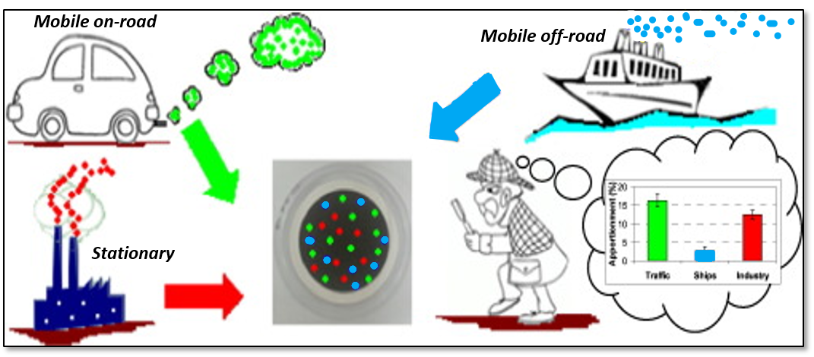
What is Source Attribution?
Meteorological Measurements
Air Quality Measurements
PM and its constituents
Metals (Cr, Ni, Mn, Fe)
Ions (sulfate, nitrate, etc.)
Elemental & organic carbon (EC/OC)
Organic compounds (Benzene, 1,3-Butadiene)
Volatile Organic Compounds (VOCs)
WIND
Source Characteristics
Identification of sources or types of sources contributing to community-scale air pollution
Allows us to estimate the relative contribution of each category of emissions sources to the elevated air quality burden

Slide 4







Sources and Source Categories
Source Category | Examples of Source Type
Stationary | Boilers, diesel engines, mineral processing facilities, paint/coating operations, chrome platers
Area-wide | Consumer products (hairspray, cleaning supplies), cooking, asphalt paving, windblown dust
Mobile (on-road) | Cars, trucks
Mobile (off-road) | Locomotives, ocean-going vessels, cranes, bulldozers, cargo-handling equipment

Slide 5
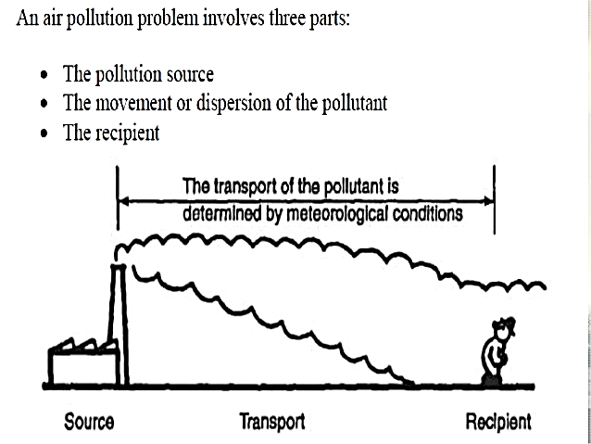
Types of Source Attribution
Transport
Source
Receptor (Monitor)
Receptor-Oriented Approaches
Chemical Mass Balance (CMB)
- Requires “fingerprint” of each source
Positive Matrix Factorization (PMF)
- Requires a lot of sampling data
Back-trajectory/Pollution roses
Source-Oriented Approaches
Relative source contribution
Air quality modeling

Slide 6
Source Attribution Approaches
Approach | Methodology | Data Requirements
Source oriented | Relative Source Contribution (Emissions Inventory Ratios) | Emissions inventories
 | Air Quality Dispersion Modeling | Emissions inventories + Wind direction/speed data
Receptor oriented | Chemical Mass Balance (CMB) | Some monitoring data + Source profiles (“fingerprints”)
 | Positive Matrix Factorization (PMF) | Substantial monitoring data (no profiles needed)

Slide 7
Summary
Source attribution can identify sources or source types contributing to the air quality burden in a community and inform emissions reduction strategy development.
Approaches can be source-oriented (inventory ratios, air quality modeling) or receptor-oriented (CMB & PMF).
Monitoring and source attribution processes are iterative, constantly improving with new, more precise data and methodologies.

Slide 8
Thank you!

